Slide 1
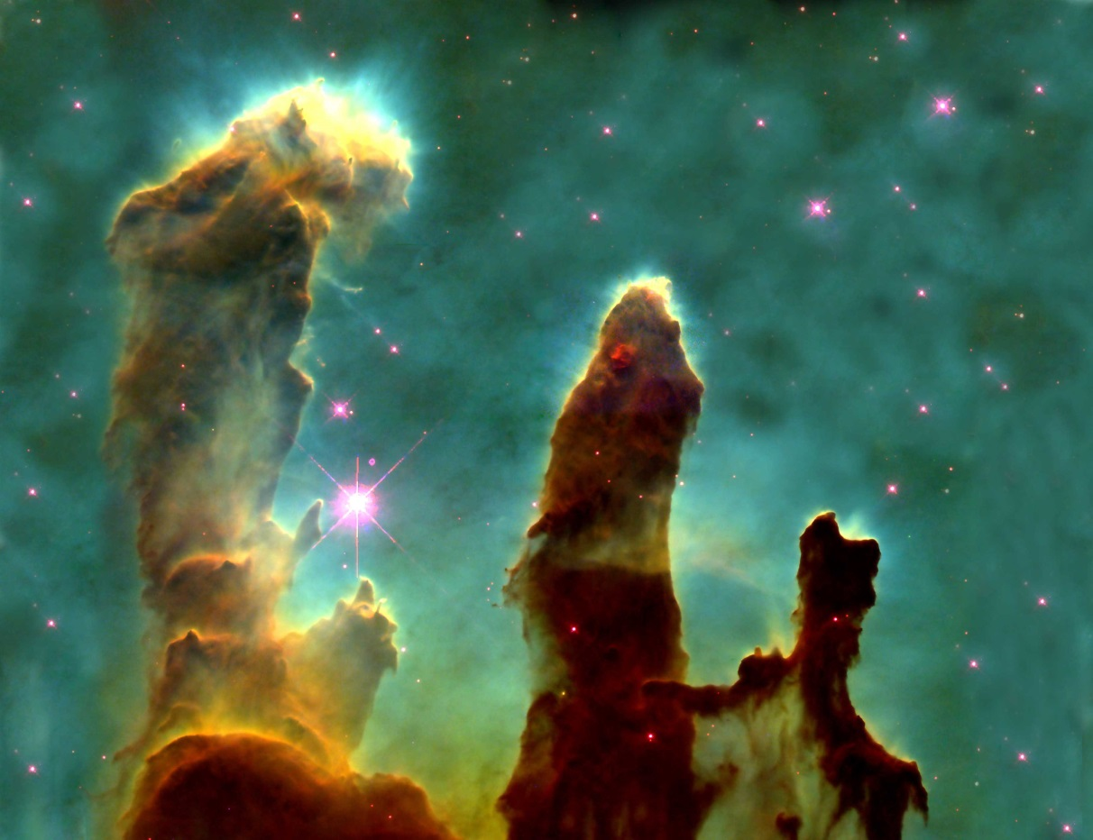
APPRECIATING HUBBLE AT HYPERSPEED
(AHAH) 3D
Presented By:
Amanda Aubry
Isaac Meisenheimer
Mentor: Dr. Rogier Windhorst

Slide 2
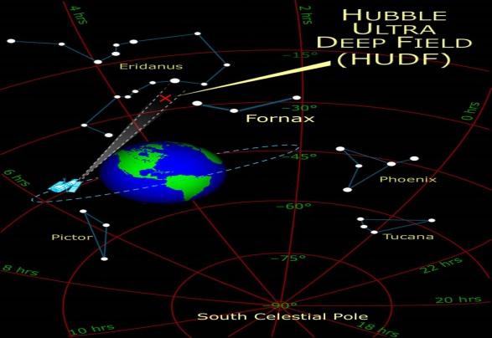
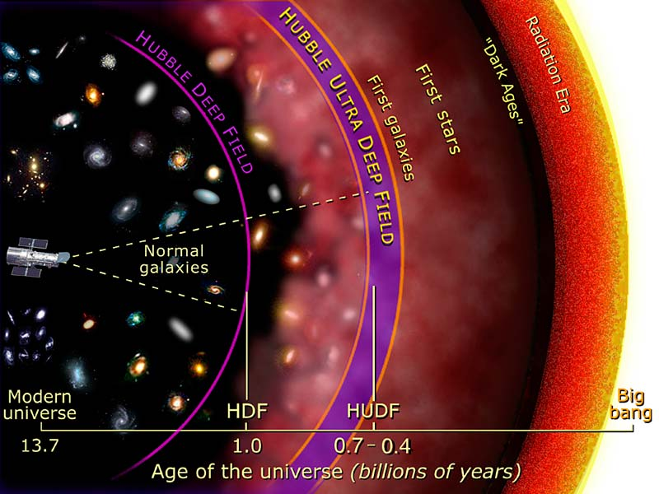
BACK IN TIME
HUBBLE ULTRA DEEP FIELD
13.2 Billion Years Ago
Ursa Major / Fornax

Slide 3
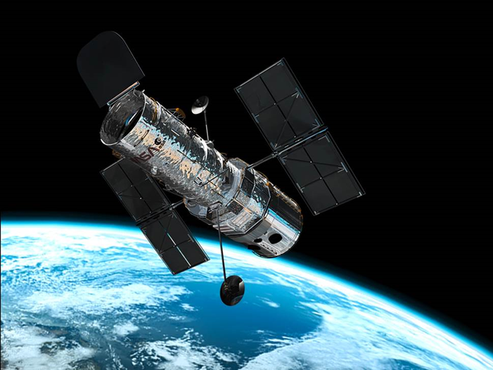
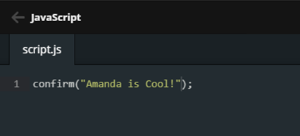
JAVA REPROGRAMMING
IMAGE INTEGRATION
Java Script
Polish Images

Slide 4
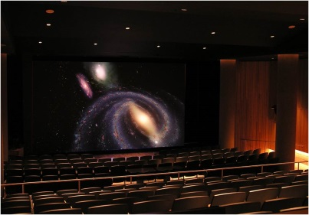
MARSTON 3D THEATER
DEFINITI SKY-SKAN
Software Platform
Guided Tour

Slide 5
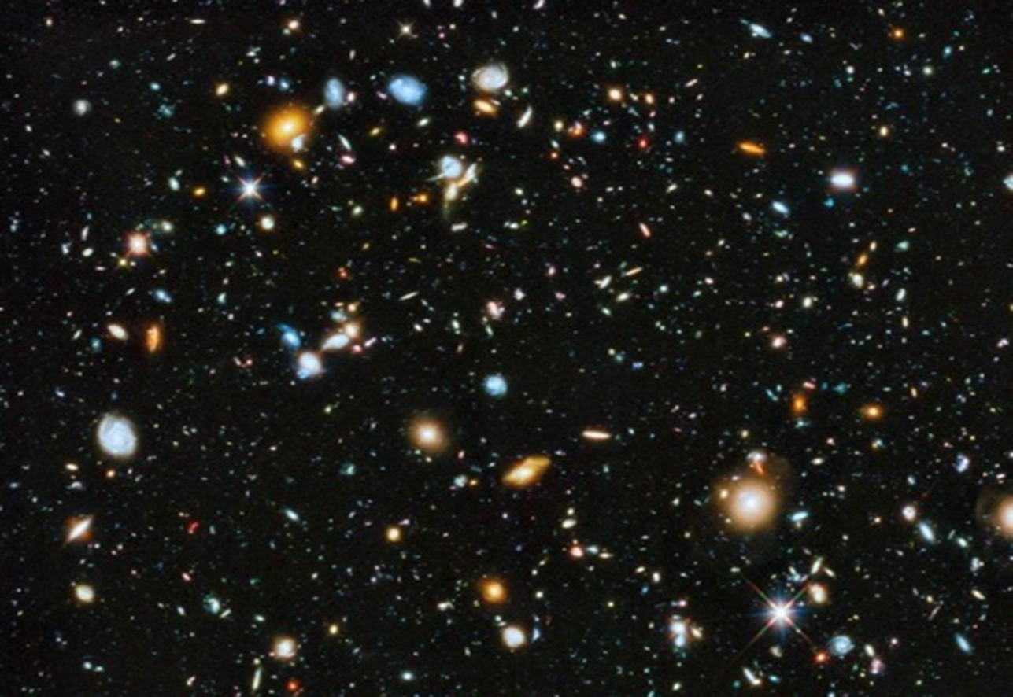
HUBBLE ULTRA DEEP FIELD
HUDF

Slide 6
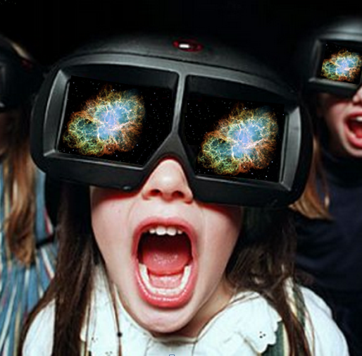
PUBLIC OUTREACH
INSPIRE THE YOUTH FOR TECHNOLOGY DEVELOPMENT
3D THEATER EXPERIENCE
Teaching Tool
Innovate To Improve

Slide 7
QUESTIONS

